Slide 1
Insurance analytics presentation by group 6

Slide 2
Group members
Ranjith Ramesh
Bhavana Chavan
Bassamma Myaleshi
Dipti
Karan
Aakash Dwivedi

Slide 3
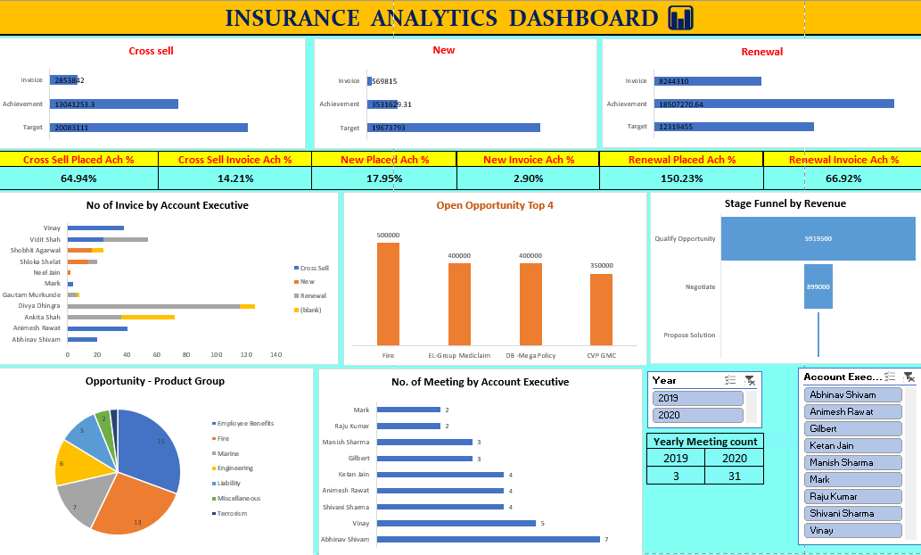
Excel Dashboard

Slide 4
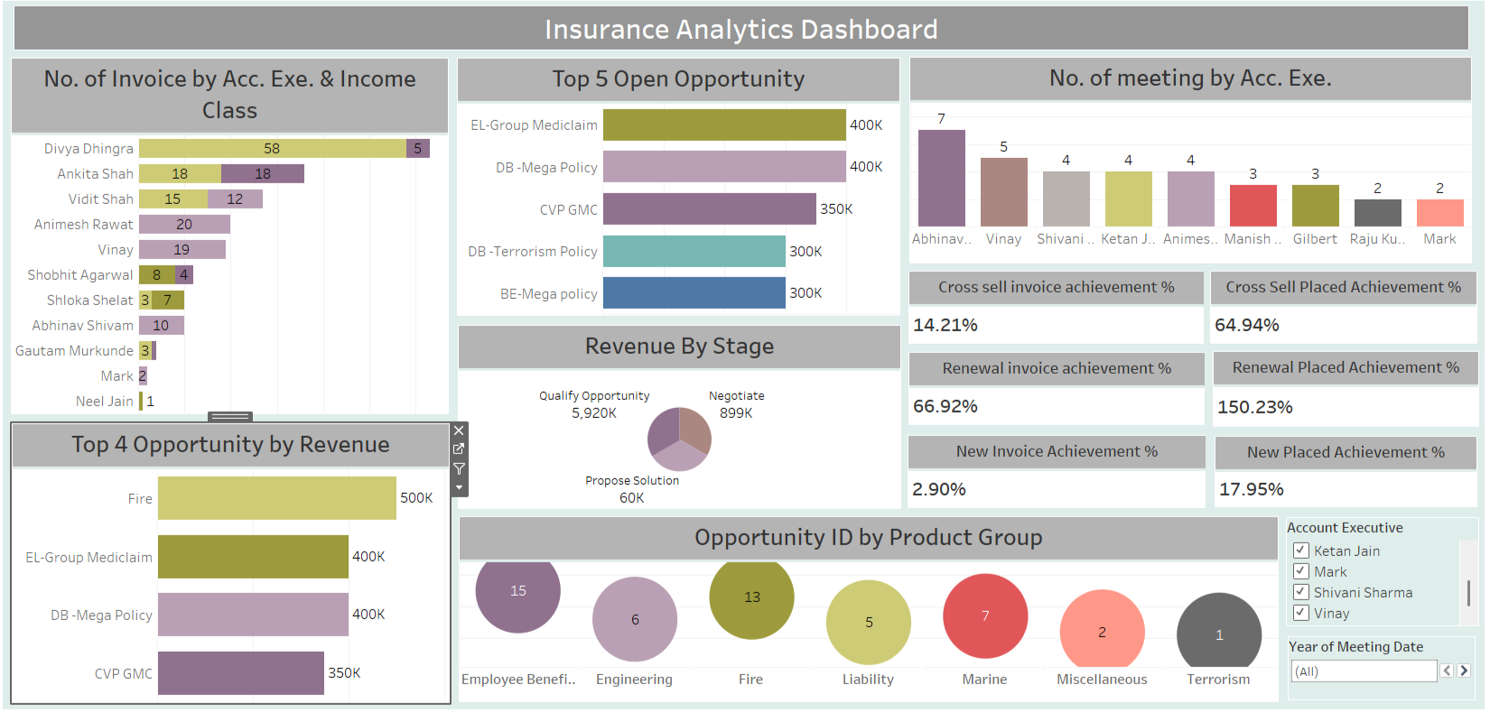
Powerbi dashboard

Slide 5
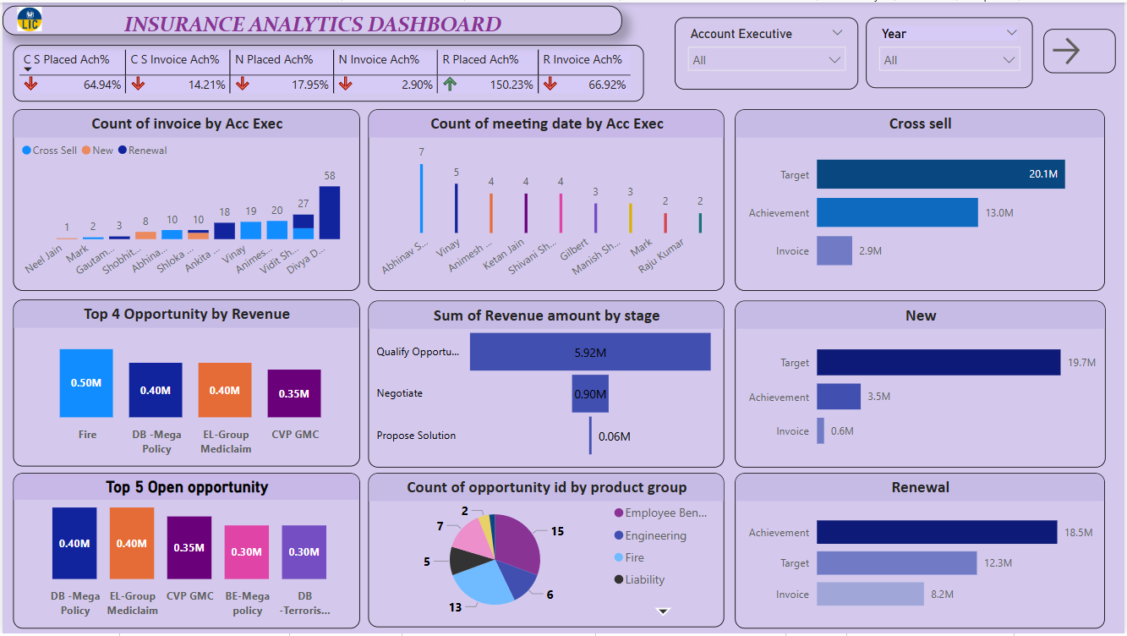
tableau dashboard

Slide 6
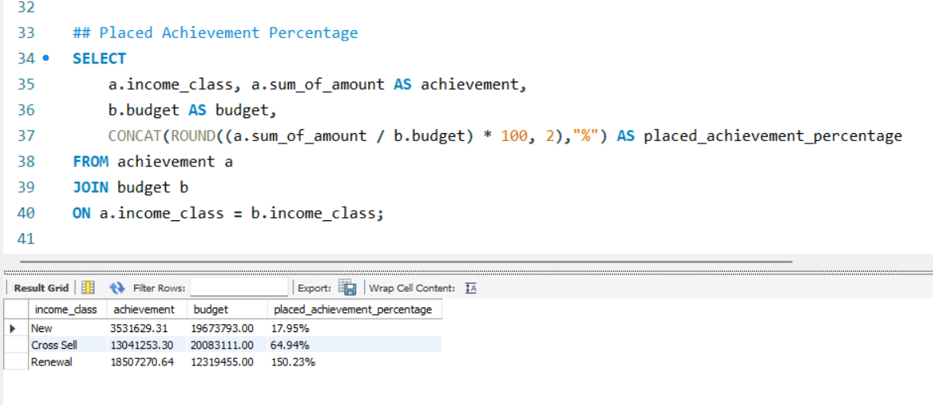
Sql kpi 1

Slide 7
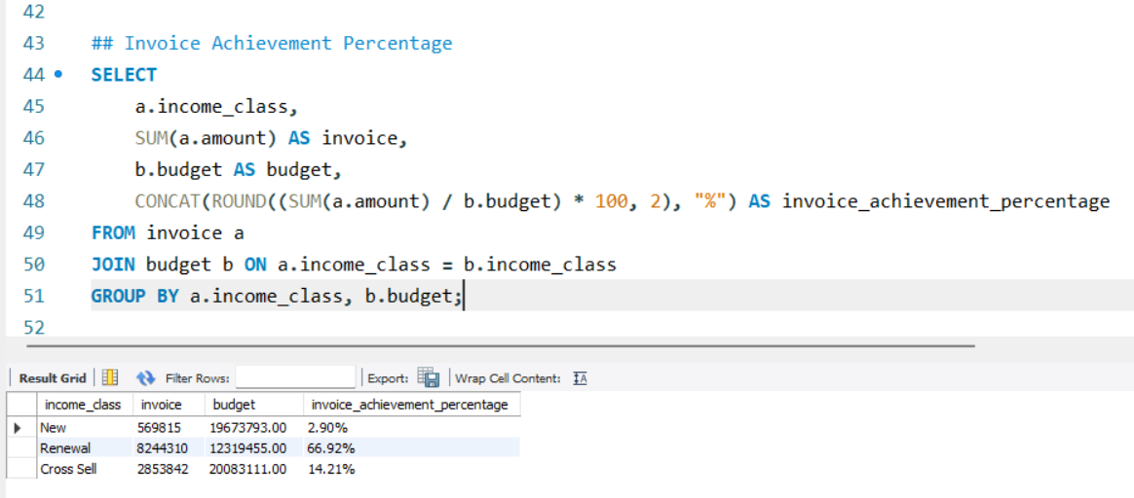
Sql kpi 2

Slide 8
Challenges faced

Slide 9
How did we overcome the challenges

Slide 10
Thank you

